Slide 1
CO321: Embedded systems

Slide 2

Introduction to AVR
Mostly from Chapter 1
The AVR microcontroller
and embedded
systems
using assembly and c

Slide 3
Topics
Microcontrollers vs. Microprocessors
Most common microcontrollers
AVR Features
AVR members

Slide 4
General Purpose Microprocessors vs. Microcontrollers
General Purpose Microprocessors
General
Purpose
Micro
processor
Data BUS
RAM
ROM
Timer
Serial
COM
Port
IO
Port
Address BUS
Control BUS
Microcontrollers
CPU
RAM
ROM
Serial
Port
Timer
I/O

Slide 5
Most common microcontrollers
8-bit microcontrollers
  AVR
  PIC
  HCS12
  8051
32-bit microcontrollers
  ARM
  PIC32

Slide 6
AVR History
The Atmel AVRTM is a family of 8-bit RISC microcontrollers produced by Atmel.
The AVR architecture was conceived by two students at the Norwegian Institute of Technology (NTH) and further refined and developed at Atmel Norway, the Atmel daughter company founded by the two chip architects.

Slide 7
AVR Architecture
What are the features of RISC?
– 1 instruction per clock cycle (pipelined)
– Lots of registers: 32 GP registers
– Register-to-register operation
Variations in the parts:
– TINY to MEGA
– ATtiny10
• Processor has only 8 pins
– ATmega128 (128K bytes flash)
• Processor has 64 pins

Slide 8
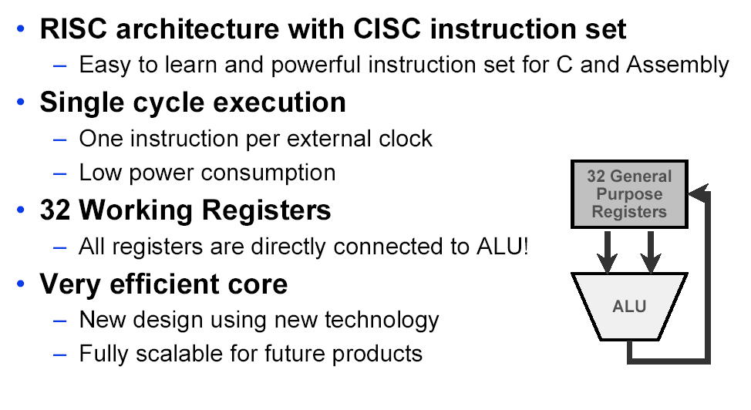
AVR Architecture

Slide 9
AVR Internal Architecture

Slide 10
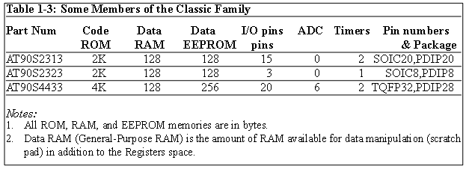
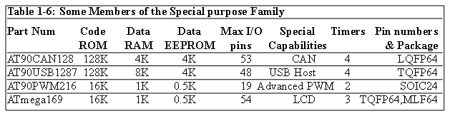
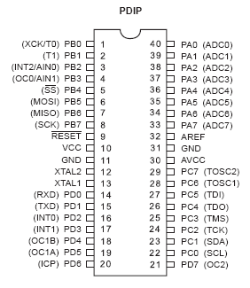
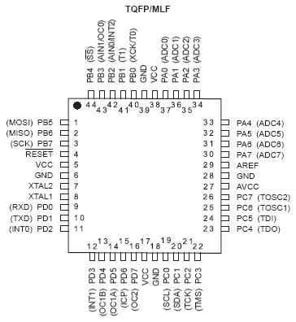
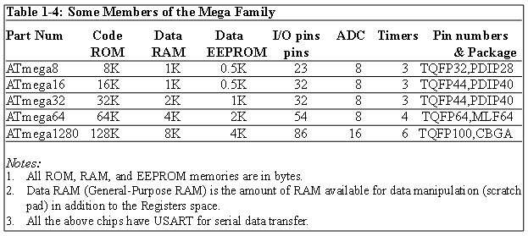
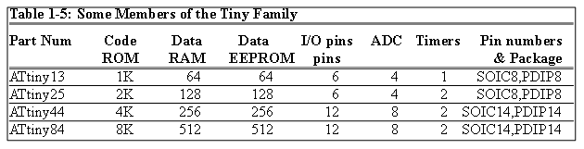
AVR Different Groups
Classic AVR
  e.g. AT90S2313, AT90S4433
Mega
  e.g. ATmega8, ATmega32, ATmega128
Tiny
  e.g. ATtiny13, ATtiny25
Special Purpose AVR
  e.g. AT90PWM216,AT90USB1287

Slide 11
Let’s get familiar with the AVR part numbers
ATmega128
Atmel
group
Flash =128K
ATtiny44
AT90S4433
Atmel
Tiny group
Flash =4K
Atmel
Classic group
Flash =4K

Slide 12
AVR Architecture
Mostly from Chapter 2 (pp 55 - 75)
The AVR microcontroller
and embedded
systems
using assembly and c

Slide 13
Topics
AVR’s CPU
  Its architecture
  Some simple programs
Data Memory access
Program memory
RISC architecture

Slide 14
AVR’s CPU
AVR’s CPU
  ALU
  32 General Purpose registers (R0 to R31)
  PC register
  Instruction decoder
CPU
ALU
R0
R1
R2
…
SREG:
H
N
Z
I
T
S
V
C
R15
R16
R17
PC
…
Instruction decoder
R30
R31
Instruction Register
registers

Slide 15
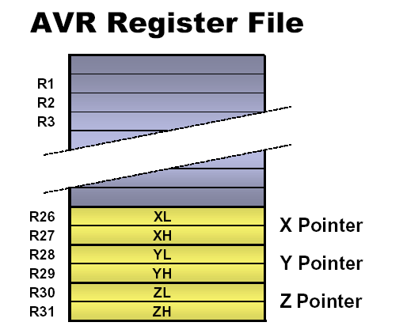
AVR Memory Space
• Program Flash
– Vectors, Code, and
(Unchangeable) Constant Data
• Working Registers
– Includes X, Y, and Z registers.
• I/O Register Space
– Includes “named” registers
• SRAM – Data Space
– Runtime Variables and Data
– Stack space
• EEPROM space
– For non-volatile but alterable data

Slide 16
AVR Addressing Modes
Register Direct, with 1 and 2 registers
I/O Direct
Data Direct
Data Indirect
  with pre-decrement
  with post-increment
Code Memory Addressing

Slide 17
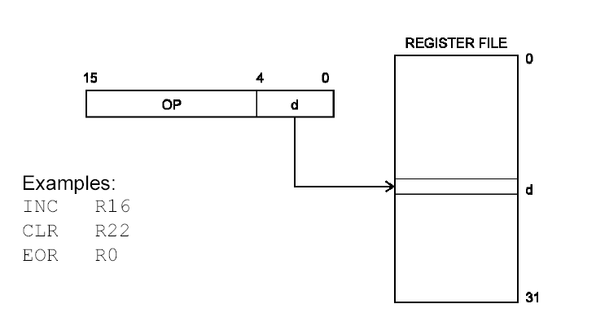
Register Direct: 1 Register

Slide 18
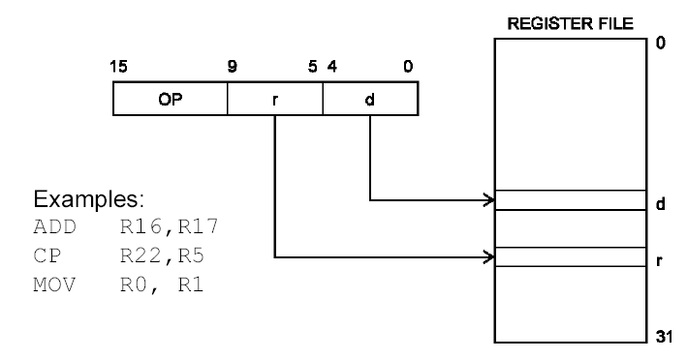
Register Direct: 2 Registers

Slide 19
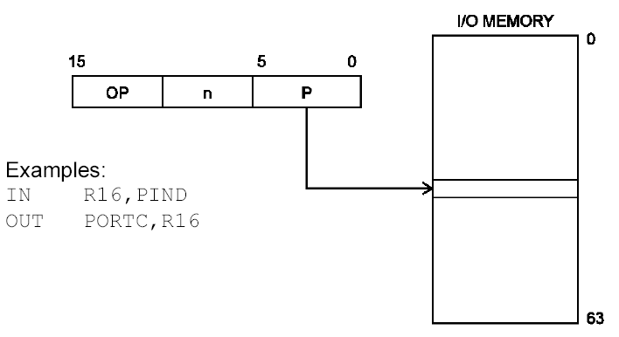
I/O Direct

Slide 20
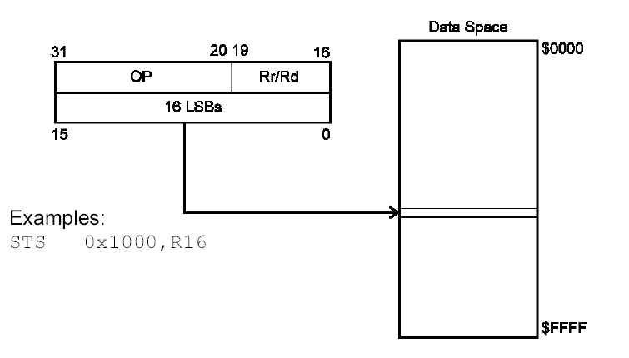
Data Direct

Slide 21
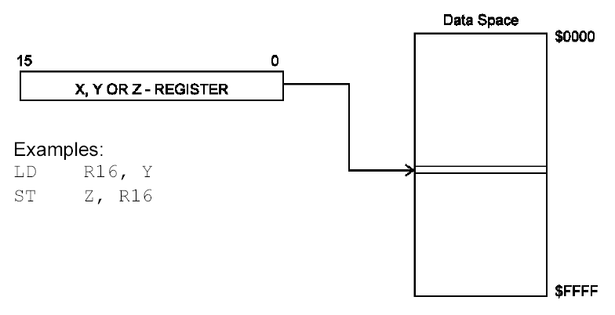
Data Indirect

Slide 22
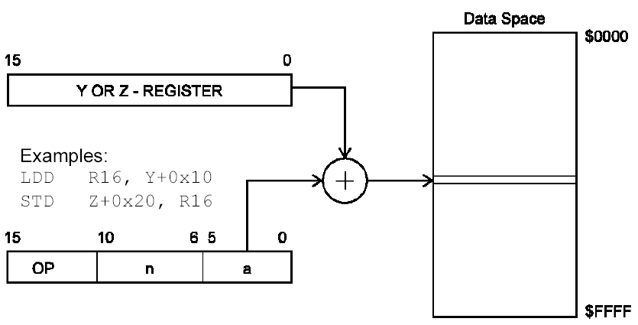
Data Indirect w/ Displacement

Slide 23
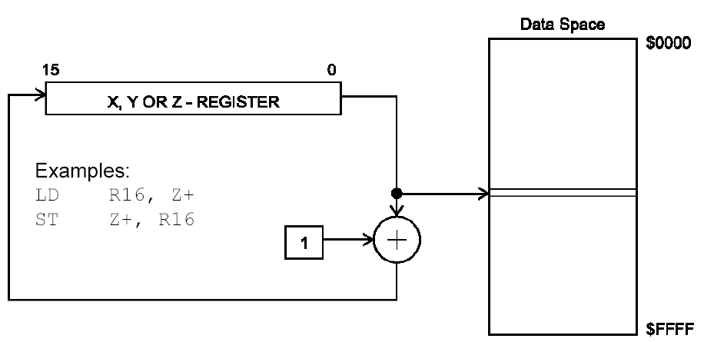
Data Indirect: Post-Increment

Slide 24
Some Simple Instructions
1. Loading values into the general purpose registers
LDI (Load Immediate)
LDI Rd, k
  Its equivalent in high level languages:
  Rd = k
Example:
  LDI R16,53
    R16 = 53
  LDI R19,132
  LDI R23,0x27
    R23 = 0x27
CPU
ALU
R0
R1
R2
…
SREG:
H
N
Z
I
T
S
V
C
R15
R16
R17
PC
…
Instruction decoder
R30
R31
Instruction Register
registers

Slide 25
Some Simple Instructions
2. Arithmetic calculation
There are some instructions for doing Arithmetic and logic operations; such as:
  ADD, SUB, MUL, AND, etc.
ADD Rd,Rs
  Rd = Rd + Rs
  Example:
  ADD R25, R9
    R25 = R25 + R9
  ADD R17,R30
    R17 = R17 + R30
CPU
ALU
R0
R1
R2
…
SREG:
H
N
Z
I
T
S
V
C
R15
R16
R17
PC
…
Instruction decoder
R30
R31
Instruction Register
registers

Slide 26
A simple program
Write a program that calculates 19 + 95
LDI R16, 19 ;R16 = 19
LDI R20, 95 ;R20 = 95
ADD R16, R20 ;R16 = R16 + R20
CPU
ALU
R0
R1
R2
…
SREG:
H
N
Z
I
T
S
V
C
R15
R16
R17
PC
…
Instruction decoder
R30
R31
Instruction Register
registers

Slide 27
A simple program
Write a program that calculates 19 + 95 + 5
LDI R16, 19 ;R16 = 19
LDI R20, 95 ;R20 = 95
LDI R21, 5 ;R21 = 5
ADD R16, R20 ;R16 = R16 + R20
ADD R16, R21 ;R16 = R16 + R21
LDI R16, 19 ;R16 = 19
LDI R20, 95 ;R20 = 95
ADD R16, R20 ;R16 = R16 + R20
LDI R20, 5 ;R20 = 5
ADD R16, R20 ;R16 = R16 + R20

Slide 28
Some Simple Instructions
2. Arithmetic calculation
SUB Rd,Rs
  Rd = Rd - Rs
Example:
  SUB R25, R9
    R25 = R25 - R9
  SUB R17,R30
    R17 = R17 - R30
CPU
ALU
R0
R1
R2
…
SREG:
H
N
Z
I
T
S
V
C
R15
R16
R17
PC
…
Instruction decoder
R30
R31
Instruction Register
registers

Slide 29
R0 thru R15
Only registers in the range R16 to R31 can be loaded immediate. We cannot load a constant into the registers R0 to R15 directly. It would have to be loaded into a valid register first then copied. To load the value of 10 into register zero (R0):
Code:
LDI R16, 10 ;Set R16 to value of 10
MOV R0, R16 ;Copy contents of R16 to R0

Slide 30
Some simple instructions
2. Arithmetic calculation
INC Rd
  Rd = Rd + 1
Example:
  INC R25
    R25 = R25 + 1
DEC Rd
  Rd = Rd - 1
Example:
  DEC R23
    R23 = R23 - 1
CPU
ALU
R0
R1
R2
…
SREG:
H
N
Z
I
T
S
V
C
R15
R16
R17
PC
…
Instruction decoder
R30
R31
Instruction Register
registers

Slide 31
Data Address Space
Example: Add contents of location 0x90 to contents of location 0x95 and store the result in location 0x313.
Example: Store 0x53 into the SPH register. The address of SPH is 0x5E
Example: What does the following instruction do?
LDS R20,2
LDS (Load direct from data space)
STS (Store direct to data space)
Example: Write a program that stores 55 into location 0x80 of RAM.
Example: Write a program that copies the contents of location 0x80 of RAM into location 0x81.
Solution:
LDS R20, 0x90 ;R20 = [0x90]
LDS R21, 0x95 ;R21 = [0x95]
ADD R20, R21 ;R20 = R20 + R21
STS 0x313, R20 ;[0x313] = R20
LDS Rd, addr ;Rd = [addr]
STS addr,Rd ;[addr]=Rd
Solution:
LDI R20, 0x53 ;R20 = 0x53
STS 0x5E, R20 ;SPH = R20
Solution:
LDI R20, 55 ;R20 = 55
STS 0x80, R20 ;[0x80] = R20 = 55
Answer:
It copies the contents of R2 into R20; as 2 is the address of R2.
Example:
LDS R1, 0x60
Example:
STS 0x60,R15 ; [0x60] = R15
Solution:
LDS R20, 0x80 ;R20 = [0x80]
STS 0x81, R20 ;[0x81] = R20 = [0x80]

Slide 32
Data Address Space
Example: Write a program that adds the contents of the PINC IO register to the contents of PIND and stores the result in location 0x90 of the SRAM
OUT (OUT to IO location)
IN (IN from IO location)
Solution:
IN R20,PINC ;R20 = PINC
IN R21,PIND ;R21 = PIND
ADD R20,R21 ;R20 = R20 + R21
STS 0x90,R20 ;[0x90] = R20
OUT IOAddr,Rd ;[addr]=Rd
IN Rd,IOaddress ;Rd = [addr]
Using Names of IO registers
Example:
OUT SPH,R12 ;OUT 0x3E,R12
IN R15,SREG ;IN R15,0x3F
Example:
OUT 0x3F,R12 ;SREG = R12
OUT 0x3E,R15 ;SPH = R15
Example:
IN R1, 0x3F ;R1 = SREG
IN R17,0x3E ;R17 = SPH

Slide 33
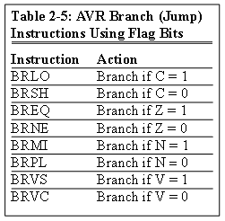
Status Register (SREG)
SREG:
I
T
H
S
V
N
Z
C
Interrupt
Carry
oVerflow
Zero
Temporary
Sign
N+V
Negative
Half carry
Example: Show the status of the C, H, and Z flags after the subtraction of 0x9C from 0x9C in the following instructions:
LDI R20, 0x9C
LDI R21, 0x9C
SUB R20, R21 ;subtract R21 from R20
Example: Show the status of the C, H, and Z flags after the subtraction of 0x23 from 0xA5 in the following instructions:
LDI R20, 0xA5
LDI R21, 0x23
SUB R20, R21 ;subtract R21 from R20
Example: Show the status of the C, H, and Z flags after the subtraction of 0x73 from 0x52 in the following instructions:
LDI R20, 0x52
LDI R21, 0x73
SUB R20, R21 ;subtract R21 from R20
Example: Show the status of the C, H, and Z flags after the addition of 0x9C and 0x64 in the following instructions:
LDI R20, 0x9C
LDI R21, 0x64
ADD R20, R21 ;add R21 to R20
Example: Show the status of the C, H, and Z flags after the addition of 0x38 and 0x2F in the following instructions:
LDI R16, 0x38 ;R16 = 0x38
LDI R17, 0x2F ;R17 = 0x2F
ADD R16, R17 ;add R17 to R16
CPU
ALU
R0
R1
R2
…
SREG:
Solution:
$52 0101 0010
- $73 0111 0011
$DF 1101 1111 R20 = $DF
C = 1 because R21 is bigger than R20 and there is a borrow from D8 bit.
Z = 0 because the R20 has a value other than zero after the subtraction.
H = 1 because there is a borrow from D4 to D3.
I
T
H
S
V
N
Z
C
Solution:
$9C 1001 1100
- $9C 1001 1100
$00 0000 0000 R20 = $00
C = 0 because R21 is not bigger than R20 and there is no borrow from D8 bit.
Z = 1 because the R20 is zero after the subtraction.
H = 0 because there is no borrow from D4 to D3.
Solution:
$A5 1010 0101
- $23 0010 0011
$82 1000 0010 R20 = $82
C = 0 because R21 is not bigger than R20 and there is no borrow from D8 bit.
Z = 0 because the R20 has a value other than 0 after the subtraction.
H = 0 because there is no borrow from D4 to D3.
Solution: 1
$9C 1001 1100
+ $64 0110 0100
$100 1 0000 0000 R20 = 00
C = 1 because there is a carry beyond the D7 bit.
H = 1 because there is a carry from the D3 to the D4 bit.
Z = 1 because the R20 (the result) has a value 0 in it after the addition.
Solution: 1
$38 0011 1000
+ $2F 0010 1111
$67 0110 0111 R16 = 0x67
C = 0 because there is no carry beyond the D7 bit.
H = 1 because there is a carry from the D3 to the D4 bit.
Z = 0 because the R16 (the result) has a value other than 0 after the addition.
R15
R16
R17
PC
…
Instruction decoder
R30
R31
Instruction Register
registers

Slide 34
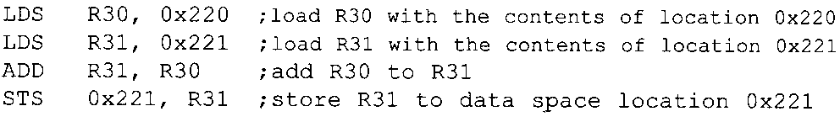
Writing Immediate Value to SRAM
You cannot copy immediate value directly into SRAM location in AVR.
This must be done via GPRs
Example: The following program adds content of location 0x220 to location 0x221

Slide 35
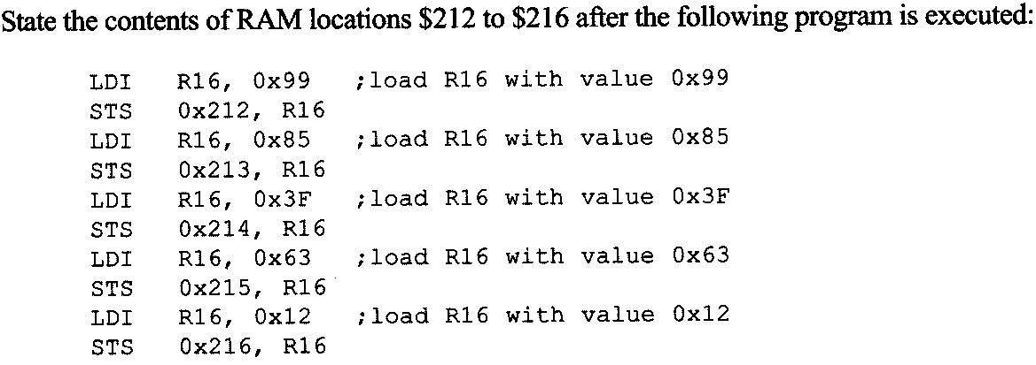
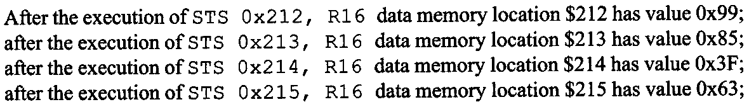
Example 2-1
Write the program in AVR Studio to verify that
Note: do not forget to add iat the beginning of the program:
.include "M32DEF.inc"

Slide 36
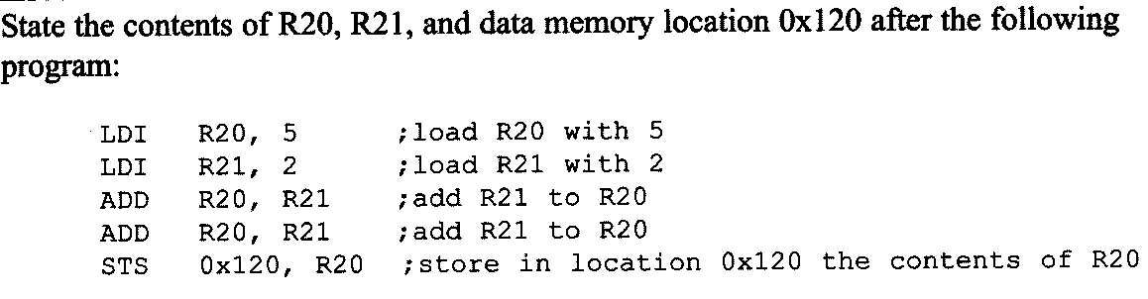
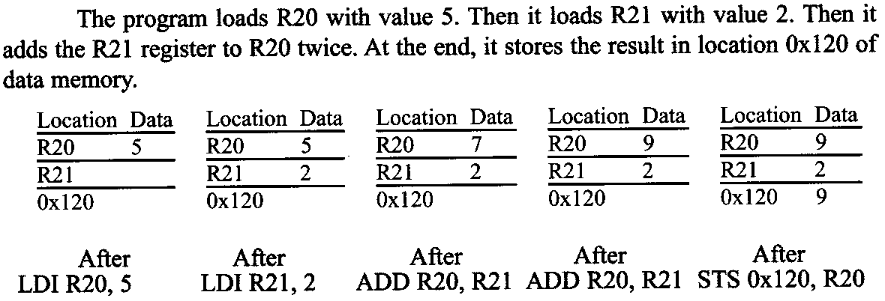
Example 2- 2
Verify using AVR Studio

Slide 37
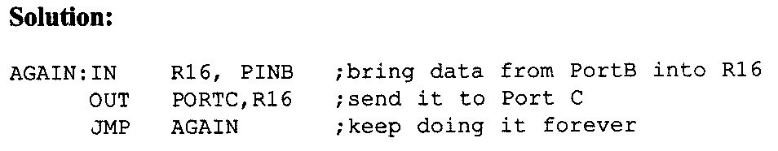
Example 2- 3

Slide 38
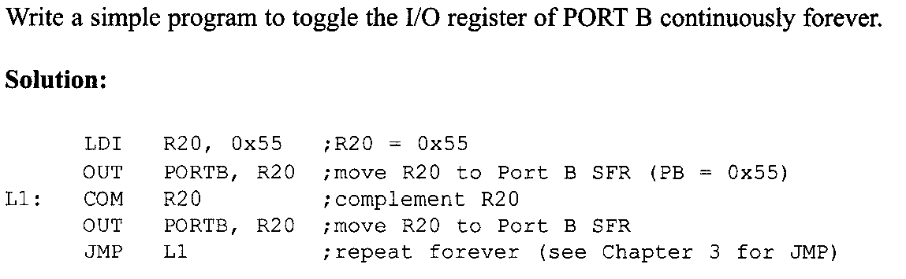
Example 2- 4

Slide 39
Exercises
Try all the exercises from the book

